Slide 1
Classification
Object Orientated Analysis and Design
Benjamin Kenwright

Slide 2
Submissions
Every group member
Submitted Group GitHub Repository Address
Demonstrated this week
Ability to use GitHub
Get comfortable with Version Control
Add/Remove Files/Documents
`Team’ Exercise

Slide 3

Discussion Activity
Explain in your own words why we use version control?
(5 Minutes)

Slide 4
Outline
Review
What do we mean by Classification?
Levels of Abstraction
Identifying Mechanisms
Summary/Discussion
Conclusion
Coursework

Slide 5
Revision Question
An object is an entity that has:
a) state, action, dependencies
b) behaviour, action, state
c) class, state, memory
d) state, identity, behavior

Slide 6
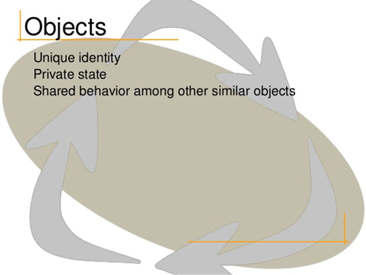
Answer
d) identity, state, behavior

Slide 7
Revision Question
What are the five meaningful metrics to measure the quality of abstraction?
a) Contracts, Cohesion, Completeness, Primitivenes, Sufficiency
b) Cohesion, Coupling, Sufficiency, Completeness, Primitivenes
c) Coupling , Cohesion, Safety, Completeness, Primitivenes

Slide 8
Answer
b) Cohesion, Coupling, Sufficiency, Completeness, Primitivenes

Slide 9
Revision Question
What is an advantage of polymorphism?
a) The same program logic can be used with objects of several related types.
b) Variables can be re-used in order to save memory.
c) Constructing new objects from old objects of a similar type saves time.
d) Polymorphism is a dangerous aspect of inheritance and should be avoided.

Slide 10
Answer
a) The same program logic can be used with objects of several related types.

Slide 11
Classification
Classification is the means whereby we order knowledge
recognize key abstractions and mechanisms with similarities (sameness)
Seeks to group things that have a commonality (e.g., structure or exhibit a common behavior)

Slide 12
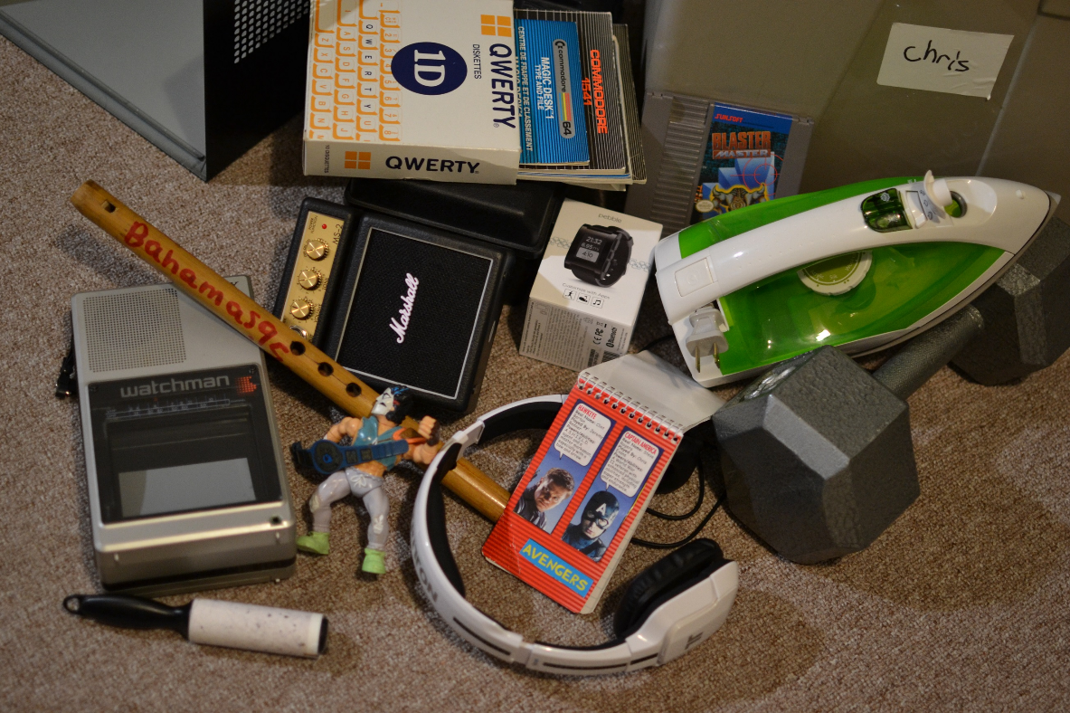
Activity
Classify the objects in the image below into groups (5 Minutes)

Slide 13
Why Classify Objects?
Classification and generalization are important functions for any language describing the physical world

Slide 14
Why Classify Objects?
Helps us to identify generalization, specialization, and aggregation hierarchies among classes
Recognizing common patterns of interaction among objects, we come to invent the mechanisms that serve as the soul of the implementation
Guides decision making about modularization
We may choose to place certain classes and objects together in the same module or in different modules, depending on the sameness we find among these declarations
Coupling and cohesion also indicate a type of sameness
Plays a role in allocating processes to processors.
We place certain processes together in the same processor or different processors, depending on packaging, performance, or reliability concerns

Slide 15
Why is Classification Difficult?

Slide 16
Why is Classification Difficult?
Boundaries are not always absolute
e.g., fuzzy or overlap multiple classifications
Example - look at your leg. Where does your knee begin, and where does it end?
Example - recognizing human speech, how do we know that certain sounds connect to form a word and are not instead a part of any surrounding words?

Slide 17
Classification Dependencies
Classification depends on what you want classification to do
Highly dependent on the reason for the classification
For example, in Biology, if you want it to reflect precisely the genetic relatedness among species, that will give you one answer. But if you want it instead to say something about levels of adaptation, then you will get another

Slide 18
Perspective

Slide 19
Important Factors
Different observers will classify the same object in different ways
Classification is relative to the perspective of the observer doing the classification
Intelligent classification requires a tremendous amount of creative insight
sometimes the answer is evident, sometimes it is a matter of taste, and at other times, the selection of suitable components is a crucial point in the analysis

Slide 20
Incremental and Iterative Nature of Classification
In practice, it is common to assert a certain class structure early in a design and then revise this structure over time
Experience, Additional knowledge discoveries, Identify previously unrecognized commonality

Slide 21
Question
Classification is relative to the perspective of the observer doing the classification
True
False

Slide 22
Answer
a) True

Slide 23
Identifying Classes and Objects
Historically, there have been three general approaches to classification:
1. Classical categorization
2. Conceptual clustering
3. Prototype theory

Slide 24
Object-Oriented Analysis
Boundaries between analysis and design are fuzzy
Focus on discovering classes and objects that form the vocabulary of the problem domain
Identify abstractions and mechanisms in different models helps provide a design solution

Slide 25
Classification Approaches
Approaches for analysis that are relevant to object-oriented systems
Classical Approaches
Behavior Analysis
Domain Analysis
Use Case Analysis
CRC Cards
Class/Responsibilities/Collaborators
Informal English Description
Structured Analysis

Slide 26
Key Abstractions and Mechanisms
Identifying Key Abstractions
appropriate choice of objects depends, of course, on the purposes to which the application will be put and the granularity of information to be manipulated

Slide 27
Question
What are the three approaches to classification:
a) classical categorization, pattern grouping, prototype theory
b) classical categorization, conceptual clustering, prototype theory
c) classical categorization, conceptual clustering, system theory

Slide 28
Answer
b) classical categorization, conceptual clustering, prototype theory

Slide 29
Question
Classification is straightforward and simple for all object orientated problems?
True
False

Slide 30
Answer
b) False

Slide 31
Question
Which of the following supports the concept of hierarchical classification?
a) Polymorphism
b) Encapsulation
c) Abstraction
d) Inheritance

Slide 32
Answer
d) Inheritance
Use of Hierarchical classification avoids defining the properties of object explicitly at each level which have acquired their properties from higher levels.

Slide 33
Level of Abstraction

Slide 34
Level of Abstraction
Classes and objects should be at the right level of abstraction: neither too high nor too low

Slide 35
Naming Key Abstractions
Objects should be named with proper noun phrases, such as the Sensor or just simply shape
Classes should be named with common noun phrases, such as Sensor or Shape
The names chosen should reflect the names used and recognized by the domain experts, whenever possible
Modifier operations should be named with active verb phrases, such as draw or moveLeft
Selector operations should imply a query or be named with verbs of the form “to be,” such as extentOf or isOpen
The use of underscores and styles of capitalization are largely matters of personal taste. No matter which cosmetic style you use, at least have your programs be self-consistent

Slide 36
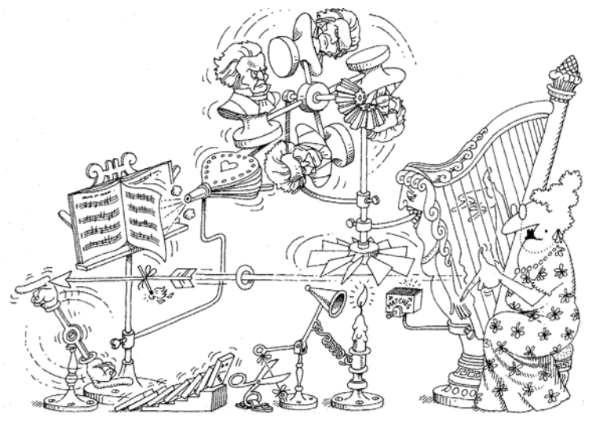
Identifying Mechanisms

Slide 37
Identifying Mechanisms
Mechanisms are the means whereby objects collaborate to provide some higher-level behavior
Mechanisms are actually one in a spectrum of patterns we find in well-structured software systems

Slide 38
Example Mechanisms
A mechanical linkage connects the accelerator directly to the fuel injectors
An electronic mechanism connects a pressure sensor below the accelerator to a computer that controls the fuel injectors (a drive-by-wire mechanism)
No linkage exists. The gas tank is placed on the roof of the car, and gravity causes fuel to flow to the engine. Its rate of flow is regulated by a clip around the fuel line; pushing on the accelerator pedal eases tension on the clip, causing the fuel to flow faster (a low-cost mechanism)

Slide 39
Summary
Clear idea of Classification in Object Orientated Analysis and Design
Classification and the challenging problem of clustering
Classification is an incremental and iterative process
Three approaches to classification include classical categorization (classification by properties), conceptual clustering (classification by concepts), and prototype theory (classification by association with a prototype)

Slide 40
This Week
Review Slides and Previous Chapters
Read Chapter 5
Online Quizzes
Researching/Planning Project
Version Control
Regularly submitting project updates
Each member of the group (evidence)
Working as a `Team’

Slide 41
Questions/Discussion

Slide 42
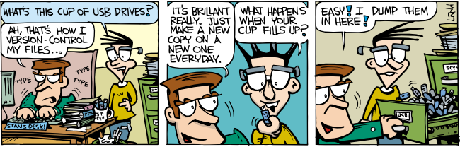
Version Control
GitHub
Register and setup your GitHub username
Create repository and every member of the group should have access

Slide 43

Coursework
Groups
Team Orientated Software Engineering Problem
Version Control
Research/Investigating Requirements/Solutions/Options
Submissions
1. System analysis: study, understand, and define requirements for the system (model of the system's functional requirements)
2. Defining the boundaries of the problem
3. Use-case model
4. Deployment view
5. Sequence diagram and operation
6. Design to code (UML design diagram)

Slide 44
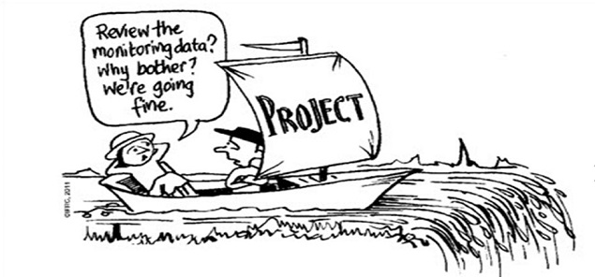
Important
Evidence based
Citations/facts/statistics
Repository history
`Group’ Project

Slide 45
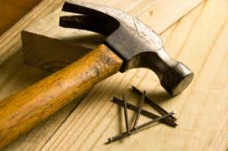
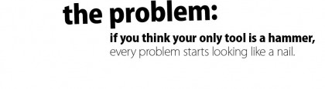

Slide 46
Critical Thinking/Logic
Ask how you could design a system `incorrectly’
What is the `wrong’ way? (why)
Don’t just look for a solution
Identify alternatives (explore/research)
What are all the possibilities?
Compare/explain

Slide 47
Requirements
Determine what you must build for your customer by defining the boundary of the problem
Determining what you must build (limits)
First step is to gather documentation of the problem
Aim and associated high-level requirements and constraints
Vision statement, functional requirements, non-functional requirements, constraints, ...

Slide 48
Final Note
Remember concepts, such as:
flexibility, encapsulation, usability, cost, problem requirements, ..
Review slides/reference material and ask how they can/cannot help solve the problem
`Object Orientated’ Analysis and Design

